Slide 1
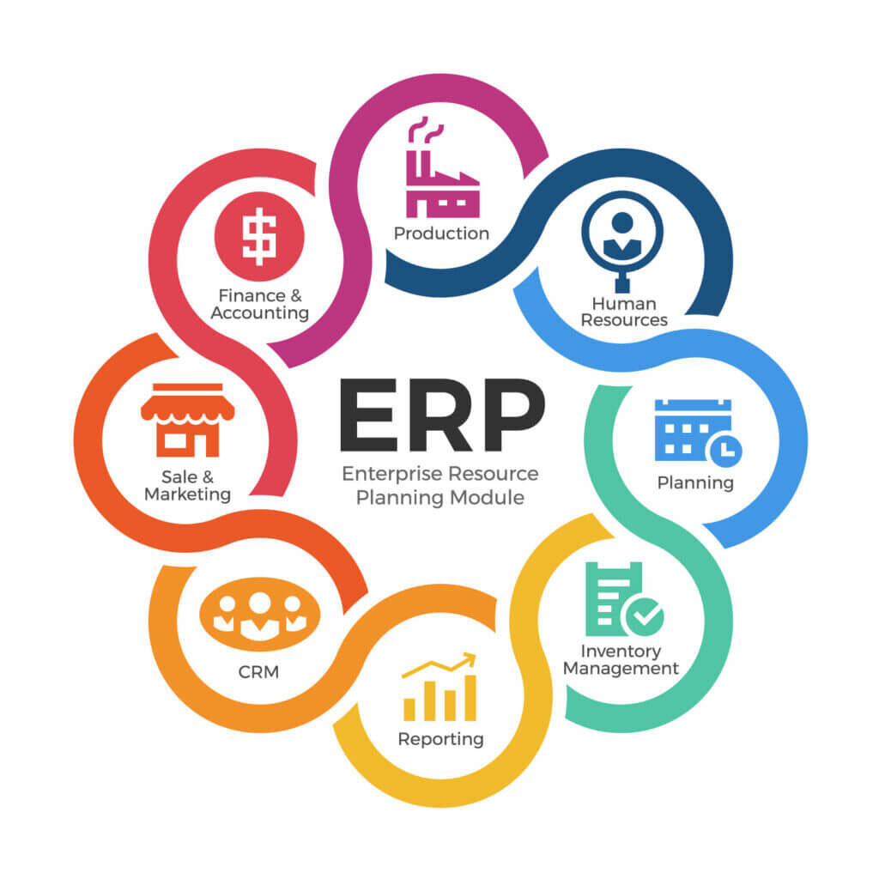
CHAPTER 1 Introduction

Slide 2
Contents of Chapter 1
1.1. Contemporary Management Sources for ERP
1.2. Gaps in functional administration
1.2.1. Overstocking
1.3. The Evolution of ERP
1.4. Benefits and difficulties in ERP implementation
1.5. Overview of business processes
1.6. Components of ERP
1.7. The layered architecture of ERP

Slide 3
1
Contemporary Management Sources for ERP

Slide 4
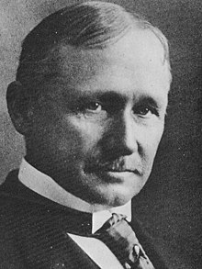
Frederick Winslow Taylor (1856 –1915) [1]
Frederick Taylor was born in Philadelphia, Pennsylvania [1]
Taylor noticed the tendency of ‘soldiering’ or slowing down of work to an easy pace (Blake & Mosely, 2011). That was the beginning of experiments which also made discoveries about time-and-motion studies as an attempt to find solution to his personnel problems. [2]
Frederick Winslow Taylor has been called the “Father of Modern Management” (Makamson, 2010) [1]

Slide 5
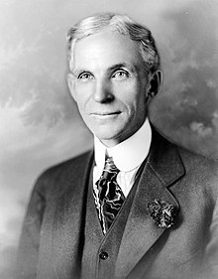
Henry Ford is widely known as the car constructor, the founder of the Ford Motor Company, the pioneer of mass production and the inventor of the moving assembly line, which many consider as the world’s greatest contribution to manufacturing.[3]
The Ford’s production system has become the characteristic American mode of production widespread all over the world. [3]
Henry Ford
(1863 – 1947)
[3]

Slide 6
Taylorism – Scientific management
The philosophy of Scientific Management developed by Taylor and his followers about a century ago had far reaching implications for business and industry as well as broader societal, political and ideological perspectives (Grachev and Rakitsky, 2013) [1]
Taylor believed that the use of engineering principles could help reduce the waste and increase production and efficiency (Taylor, 1947). Taylor identified three causes of antagonism and inefficiency:
Fallacious belief of workers that increased output would lead to unemployment inevitably [2]
Defective system of management which makes workers to restrict output to protect their interest [2]
Rule of thumb which is inefficient and efforts wasting. [2]

Slide 7

Example – Scientific management in McDonal’s operation
People working in McDonald’s must follow its instruction to do the job, normally one person in one position.
For instance, when customer order a ‘big mac’ combo, people who making buns will toast the bun and pass it on to the person who making burgers and wrapping it up ready for customer. People who making fires will put it into the box, finally who in the front counter puts all these together for the customer.

Slide 8
Problem!
Each part of the business operates independently, so there are still some problems as follows: delays in business process execution, overstocking, lack of transparency of information between departments, …

Slide 9
2
Gaps in functional administration

Slide 10

Overstocking
For example: Nike stocks fall as overstocked inventory weighs on earnings
As delivery times and consumer demand rose this year, retailers responded by ordering inventory earlier than usual. When in-transit shipping time began to improve quickly, Nike CFO Matthew Friend said, it led to swelling inventories. [5]

Slide 11
3
The Evolution of ERP

Slide 12
Evolution of ERP
Data system
ERP
01
02
03
04
Functional System
Extended ERP

Slide 13
The evolution of ERP
Data system
Functional System
01
02
In 1960’s automating their inventory control systems using inventory control packages (IC) and Material Requirements Planning (MRP) systems were developed in the 1970’s
Generation of the new software systems called Manufacturing Resources Planning (MRP II) were introduced in the 1980’s
ERP
Extended ERP
03
04
ERP systems first appeared in the late 1980’s and the beginning of the 1990’s with the power of enterprise-wide inter-functional coordination and integration
Extended ERP includes other software and business processes

Slide 14
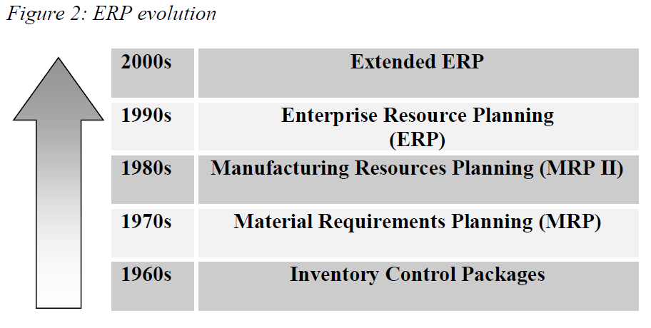
The evolution of ERP

Slide 15
Data system
In 1960’s most organizations designed, developed and implemented centralized computing systems, mostly automating their inventory control systems using inventory control packages (IC)this was the first-generation centralized computing systems. [6]
Material Requirements Planning (MRP) systems were developed in the 1970’s which involved mainly planning the product or parts requirements according to the master production schedule. [6]

Slide 16
Functional System
The new software systems called Manufacturing Resources Planning (MRP II) were introduced in the 1980’s with an emphasis on optimizing manufacturing processes by synchronizing the materials with production requirements. [6]
MRP II included areas such as shop floor and distribution management, project management, finance, human resource and engineering [6]

Slide 17
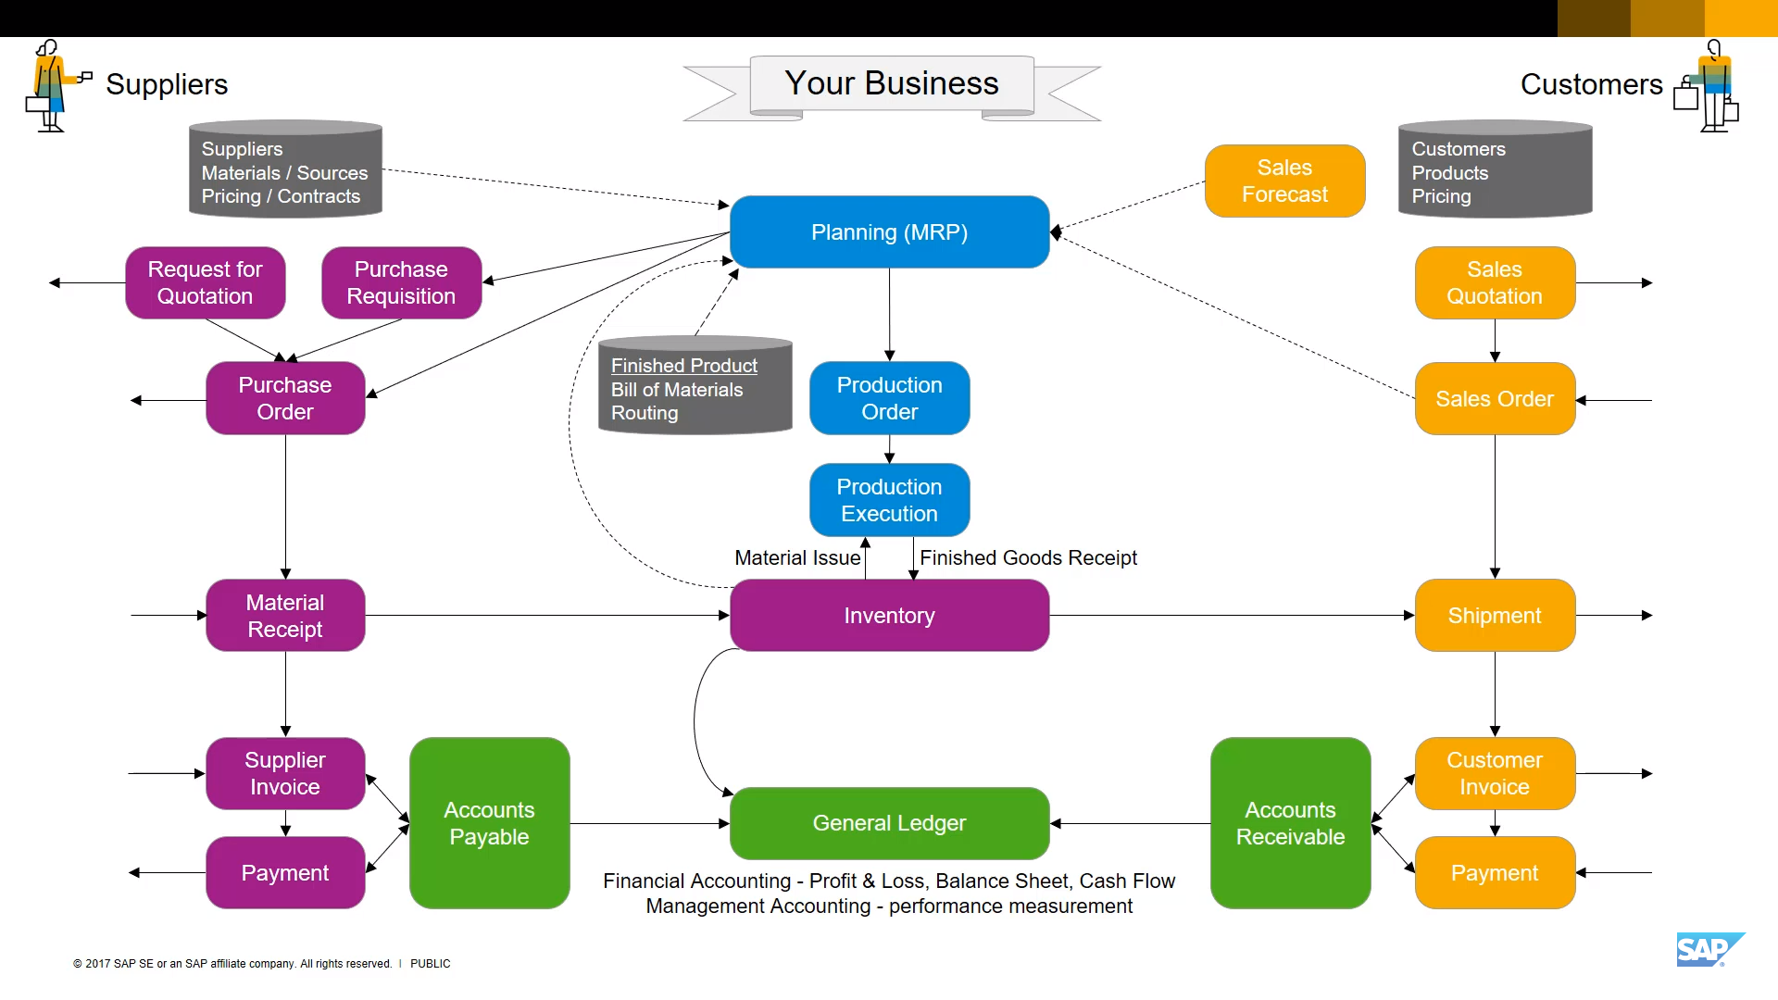
ERP

Slide 18
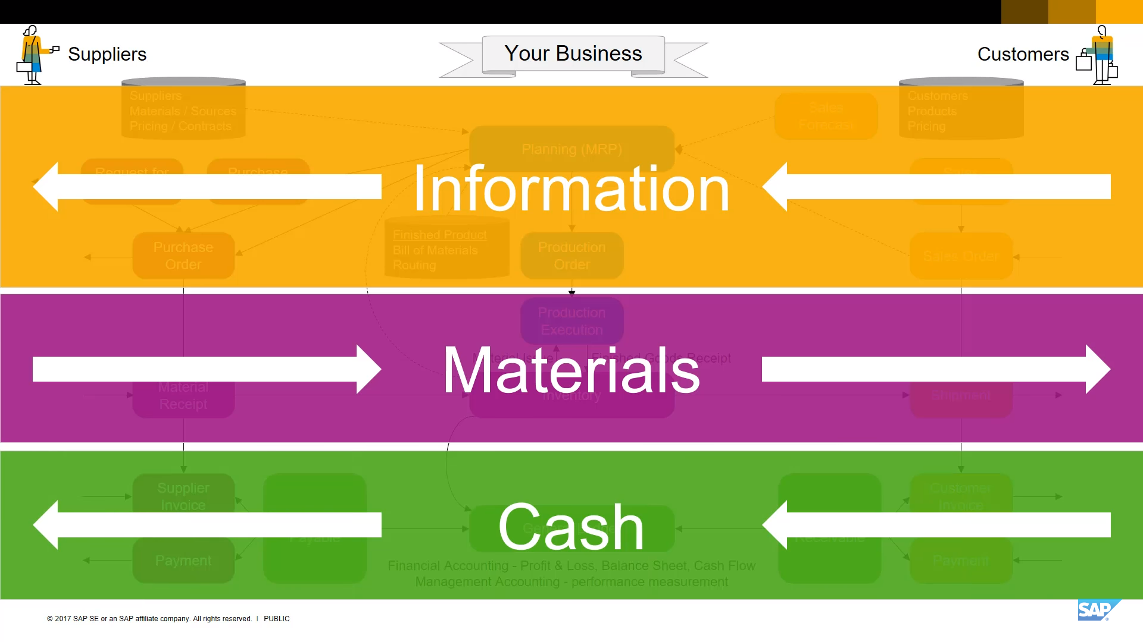
ERP

Slide 19
What is ERP ?
ERP is a system that optimizes the flow of information, materials, and cash in an organization.

Slide 20
Extended ERP
Extended ERP focuses on external activities to promote the management of connections with clients, vendors, transporters, and other parties. Popular extended ERP modules that could be used by organizations include those for supply chain management, business intelligence, e-commerce, and customer relations. [7]
Third-party applications may be used to extend ERP systems, often through vendor-supplied interfaces such as: CRM, PLM, SCM, PDM,… [7]

Slide 21
4
Benefits and difficulties in ERP implementation

Slide 22
Benefits of ERP
Enhanced data accuracy
Better customer service
Enhanced collaboration
Improved on-time delivery

Slide 23
5
Overview of business processes

Slide 24
Difficulties of ERP
Cost
Resistance to change
Complexity
Time-consuming implementation

Slide 25
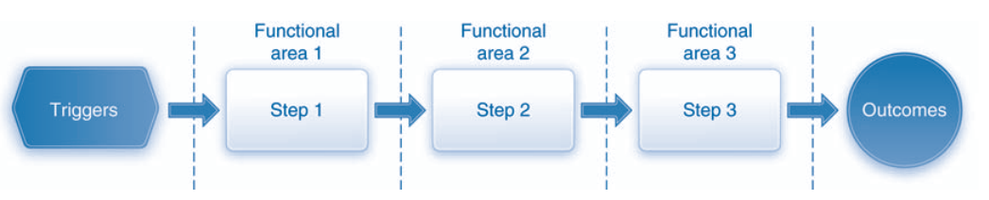
Business process
[8]
A business process is a set of tasks or activities that produce desired outcomes. Every process is triggered by some event, such as receiving a customer order or recognizing the need to increase inventory. [8]

Slide 26
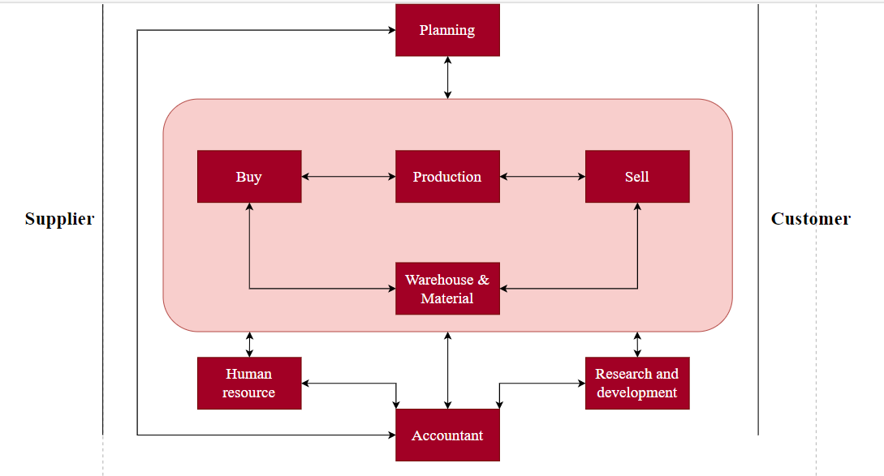
Business process
The inventory and warehouse management (IWM) process (store)
Is used to store and track the materials.[8]
The material planning process ( plan)
Uses historical data and sales forecasts to plan which materials will be procured and produced and in what quantities. [8]
The production process (make)
The fulfillment process (sell )
The procurement process (buy )
Involves the actual creation of the products within the organization. [8]
Consists of all the steps involved in selling and delivering the products to the organization’s customers. [8]
Refers to all of the activities involved in buying or acquiring the materials used by the organization, such as raw materials needed to make products.[8]
[9]
Human capital management (HCM) processes (people)
Focus on the people within the organization and include functions such as recruiting, hiring, training, and benefits management.[8]
The lifecycle data management process (design)
Supports the design and development of products from the initial product idea stage through the discontinuation of the product.[8]

Slide 27
6
Components of ERP

Slide 28
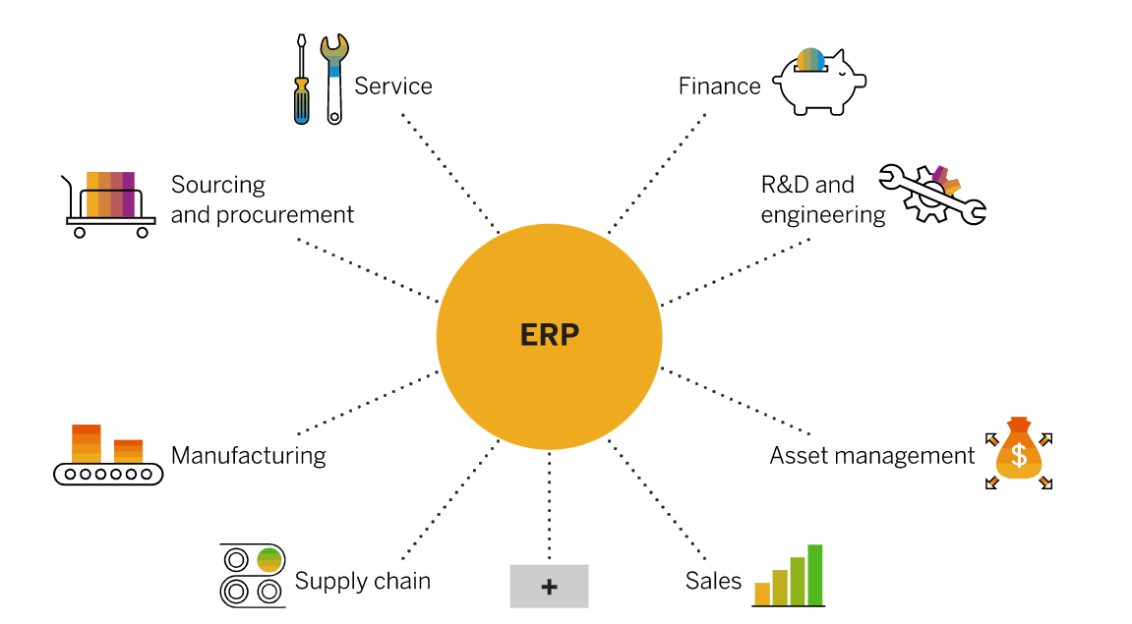
Enterprise resource planning systems include a variety of different modules. Each ERP module supports specific business processes – like finance, procurement, or manufacturing – and provides employees in that department with the transactions and insight they need do their jobs. Every module connects to the ERP system, which delivers a single source of truth and accurate, shared data across departments.[10]

Slide 29
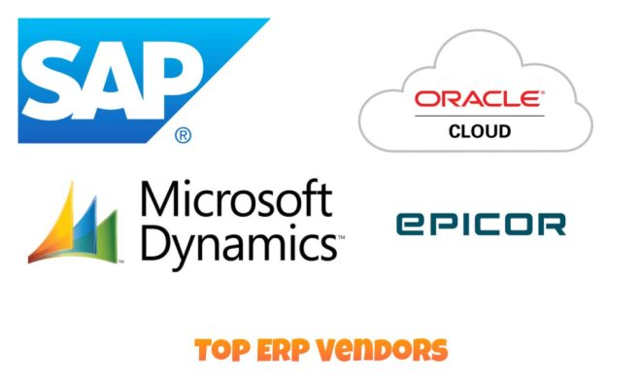
Top ERP vendors in 2023 [11]

Slide 30
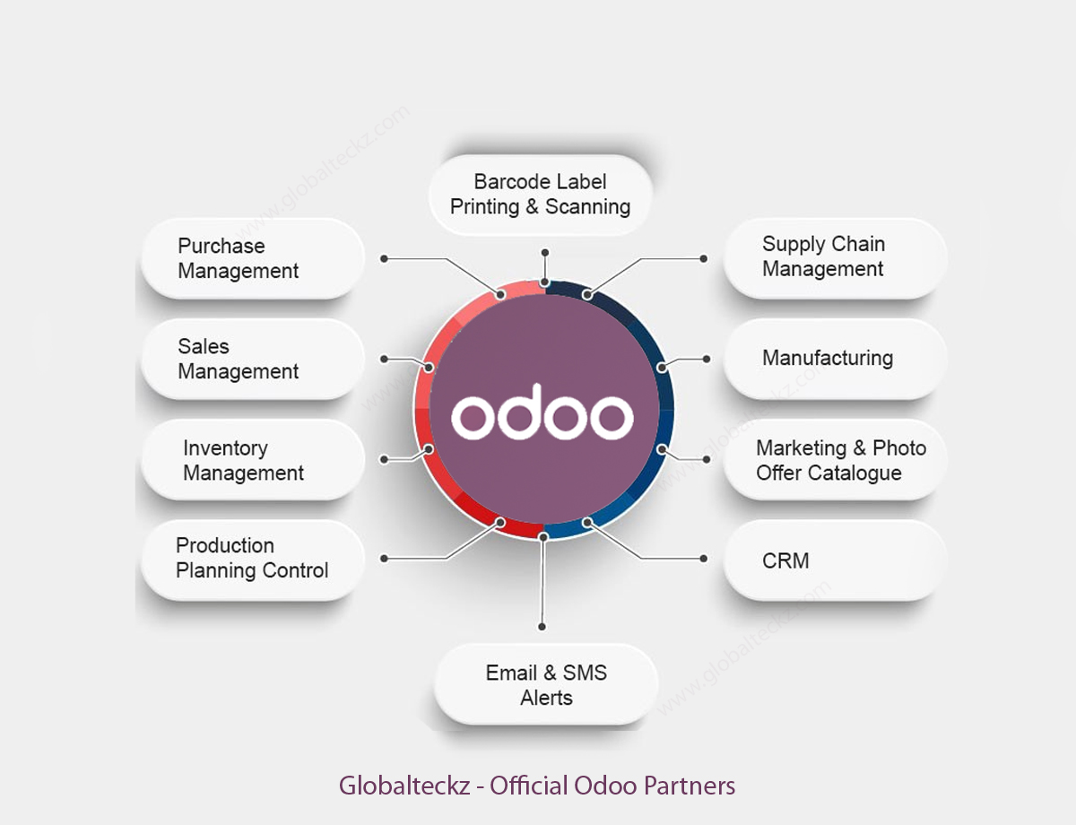
Odoo
Odoo for Fabien Pinckaers started as TinyERP, one of several projects completed during his university days. It was his most successful project, eventually becoming OpenERP and then Odoo. TinyERP was established in March of 2002 and first published in 2005. After three years on the market, a decision to no longer is small led to the name change to OpenERP. Odoo was named to Deloitte's Technology Fast 50 list of fastest-growing companies in Belgium in 2013, with a five-year growth.[12]

Slide 31
7
The layered architecture of ERP

Slide 32
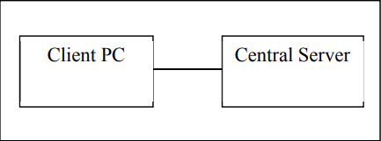
Two-tier ERP architecture
ERP architecture design was based on client/Server processing which means that processed work will be divided between two computers Client and Server. Client is the presentation logic for users while Server is the processing and storage logic. This design was named Two-tier architecture..[13]

Slide 33
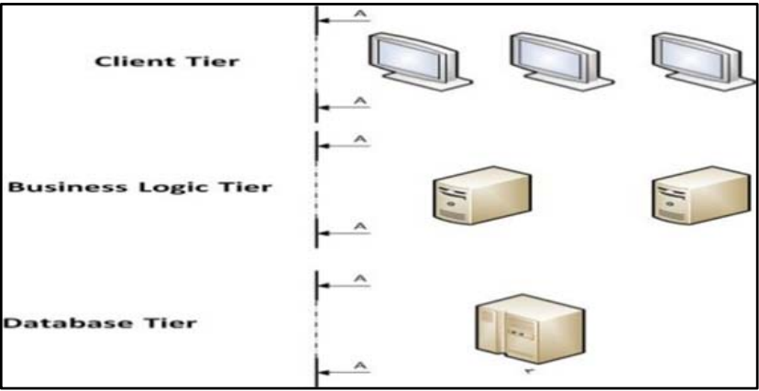
Three-tier ERP architecture
Three-tier ERP architecture was introduced as a solution for two-tier ERP problems. It consists of three layers such as Presentation layer (Graphical User Interface (GUI)), Application layer, and database layer. Presentation Layer is where data is presented for clients. Application layer is responsible for distributing requests across different applications servers and for business logic execution. Furthermore, Application layer acts as an interface that facilitate communication between Database layer and User interface (presentation layer). Database layer is responsible of data storage, edit, add, and delete[13]

Slide 34
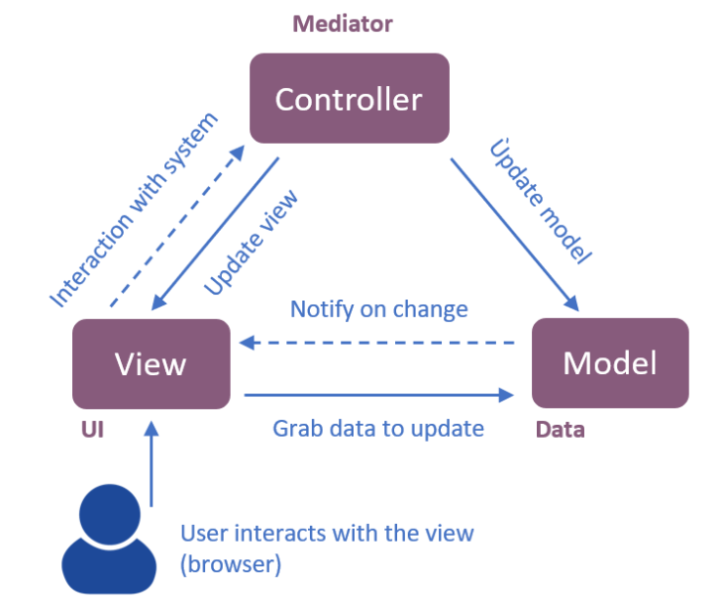
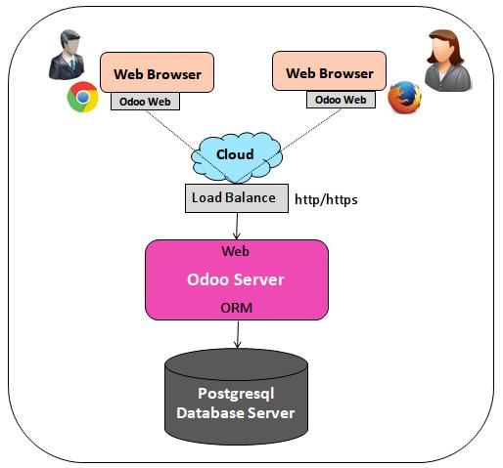
Odoo is a multi-tenant, three-tier architecture: database tier for data storage, application tier for processing and functionalities and presentation tier providing the user interface. Those are separate layers inside Odoo. The application tier itself is written as a core; multiple additional modules can be installed in order to create a particular instance of Odoo adapted to specific needs and requirements. Moreover, Odoo follows the Model-View-Controller (MVC) architectural pattern.[14]

Slide 35
References
[1] : Anne M. Blake, James L. Moseley “Frederick Winslow Taylor: One Hundred Years of Managerial Insight” International Journal of Management Vol. 28 No. 4 Part 2 Dec 2011
[2] : Mashudu Nethavhani, “The contributions of Fredrick Taylor to Management Science”23 October 2020
[3]: Nikola Tomac, Radoslav Radonja, Jasminka Bonato, Analysis of Henry Ford’s contribution to production and management, Scientific Journal of Maritime Research 33 (2019) 33-45
[7]: ERPDATASECURITY, “Extended Enterprise Resource Planning: Leveraging the Advantages Extended Enterprise Resource Planning: Leveraging the Advantages” ERPAPPLICATIONS SEPTEMBER 15, 2020 [8]:Magal, Simha R., and Jeffrey Word. Integrated business processes with ERP systems. Wiley Publishing, 2011.
[9] : PGS.TS Nguyễn Đình Thuân, Ths Đỗ Duy Thanh Hoạch định nguồn lực doanh nghiệp - ERP. Nhà xuất bản đại học quốc gia thành phố Hồ Chí Minh – 2016
[10]: https://www.sap.com/sea/insights/what-is-erp.html#:~:text=Enterprise%20resource%20planning%20(ERP)%20is,services%2C%20procurement%2C%20and%20more.
[11] https://www.devteam.space/blog/erp-vendors/
[12] https://www.erpxcloud.com/blog/our-blogs-2/odoo-tinyerp-207
[13] Dania Mahmoud Bahssas, Dr. Adnan Mustafa AlBar, Md. Rakibul Hoque* . Enterprise Resource Planning (ERP) Systems: Design, Trends and Deployment
[14] https://2021.desosa.nl/projects/odoo/posts/essay_2/

Slide 36


